Slide 1
Repeated-measures designs (GLM 4)
Chapter 14

Slide 2
Terms
Between subjects = independent
Each subject gets only one level of the variable.
Repeated measures = within subjects = dependent = paired
Everyone gets all the levels of the variable.
See confusion machine page 545

Slide 3
RM ANOVA
Now we need to control for correlated levels though …
Before all levels were separate people (independence)
Now the same person is in all levels, so you need to deal with that relationship.

Slide 4
RM ANOVA
Sensitivity
Unsystematic variance is reduced.
More sensitive to experimental effects.
Economy
Less participants are needed.
But, be careful of fatigue.

Slide 5
RM ANOVA
Back to this term: Sphericity
Relationship between dependent levels is similar
Similar variances between pairs of levels
Similar correlations between pairs of levels
Called compound symmetry
The test for Sphericity = Mauchley’s
It’s an ANOVA of the variance scores

Slide 6
RM ANOVA
It is hard to meet the assumption of Sphericity
In fact, most people ignore it.
Why?
Power is lessened when you do not have correlations between time points
Generally, we find Type 2 errors are acceptable

Slide 7
RM ANOVA
All other assumptions stand:
(basic data screening: accuracy, missing, outliers)
Outliers note … now you will screen all the levels … why?
Multicollinearity – only to make sure it’s not r = .999+
Normality
Linearity
Homogeneity/Homoscedasticity

Slide 8
RM ANOVA
What to do if you violate it (and someone forces you to fix it)?
Corrections – note these are DF corrections → which affect the cut off score (you have to go further) → which lowers the p-value

Slide 9
RM ANOVA
Corrections:
Greenhouse-Geisser
Huynh-Feldt
Which one?
When ε (sphericity estimate) is > .75 = Huynh-Feldt
Otherwise Greenhouse-Geisser
Other options: MANOVA, MLM

Slide 10
An Example
Are some Halloween ideas worse than others?
Four ideas tested by 8 participants:
Haunted house
Small costume (brr!)
Punch bowl of unknown drinks
House party
Outcome:
Bad idea rating (1-12 where 12 is this was dummmbbbb).

Slide 11
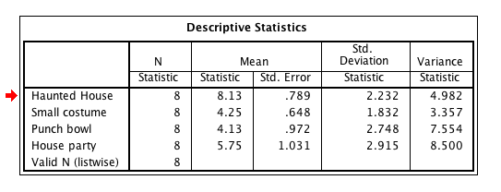
Data

Slide 12
Variance Components

Slide 13
Variance Components
SStotal = Me – Grand mean (so this idea didn’t change)
SSwithin = Me – My level mean (this idea didn’t change either)
BUT I’m in each level and that’s important, so …

Slide 14
Variance Components
SSwithin = SSm + SSr
SSm = My level – GM (same idea)
SSr = SSw – SSm (basically, what’s left over after calculating how different I am from my level, and how different my level is the from the grand mean)

Slide 15
Variance Components
SSbetween?
You will get this on your output and should ignore it if all IVs are repeated.
Represents individual differences between participants
SSb = SSt - SSw

Slide 16
Note
Please use the really great flow chart on page 556

Slide 17
SPSS
Quick note on data screening:
We’ve talked a lot about “not screening the IV”.
In repeated measures – each column is both and IV and a DV.
The IV is the levels (you can think of it as the variable names)
The DV is the scores within each column.
So you must screen all the scores.

Slide 18
SPSS
Quick note on data screening:
One way to help keep this straight:
Did the person in the experiment “make” that score?
If yes → screen it
If no → don’t screen it
Examples of no:
Gender, ethnicity, experimental group

Slide 19
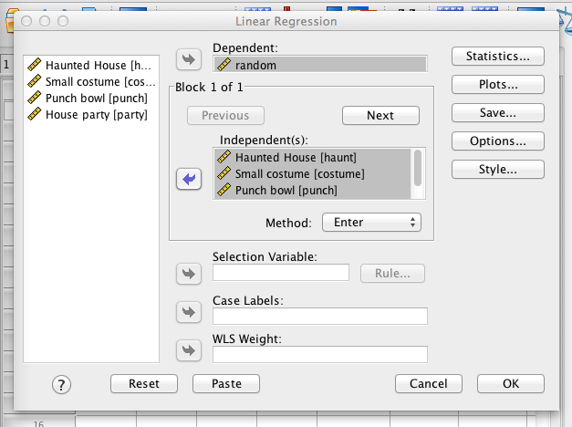
SPSS

Slide 20
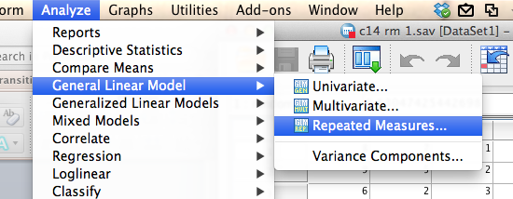
SPSS
Analyze > General Linear Model > Repeated Measures

Slide 21
SPSS
Give the IV an overall name
Within Subject Factor Name
Indicate the number of levels (columns)
Hit add
Hit Define

Slide 22
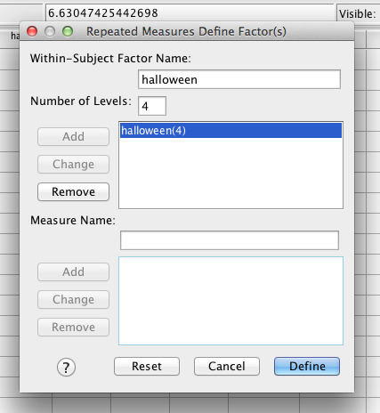
SPSS

Slide 23
SPSS
You now have spots for all the levels:
Important: SPSS assumes the order is important for some types of contrasts (trend analysis) and for two-way designs.
If there’s no order, don’t worry about it.
If it’s a time thing, put them in order.

Slide 24
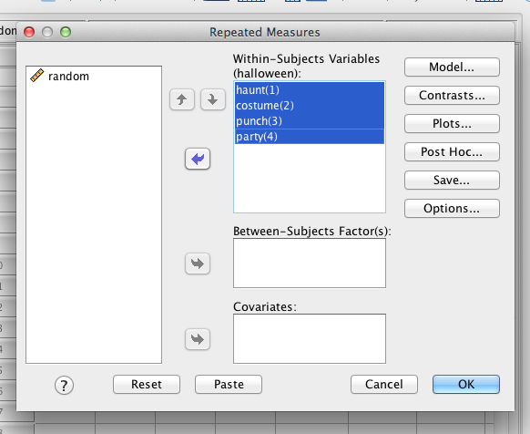
SPSS
Move over the levels.

Slide 25
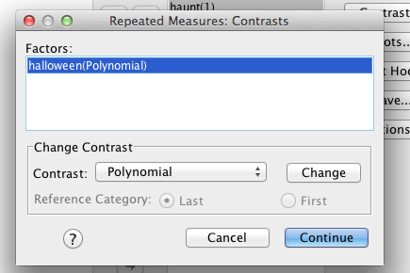
SPSS
Contrasts:
These have the exact same rules we’ve described before (chapter 11 notes)
Polynomial is still a trend analysis.

Slide 26
SPSS
For fun, click post hoc.
BOO!

Slide 27
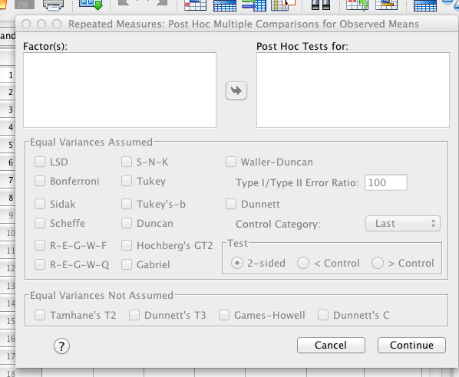
SPSS

Slide 28
SPSS
Hit options
Move over the IV.
Click descriptive statistics, estimates of effect size.
Homogeneity?
We do not have between subjects, so you can click this button, but it will not give you any output (Levene’s).
I usually click it because I forget → won’t hurt you and you won’t forget it on between subjects or mixed designs.

Slide 29
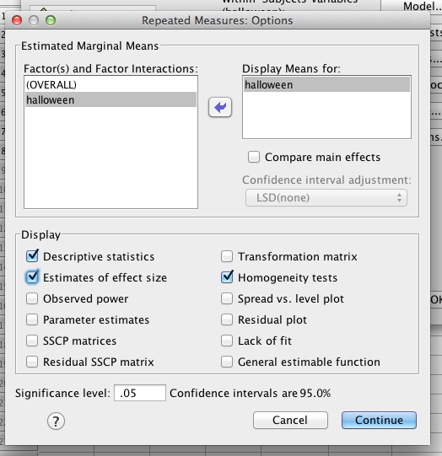
SPSS
\

Slide 30
SPSS
See compare main effects?
Click it!
LSD = Tukey LSD = no correction = dependent t test without the t values.
Bonferroni and Sidak are exactly the same as before.

Slide 31
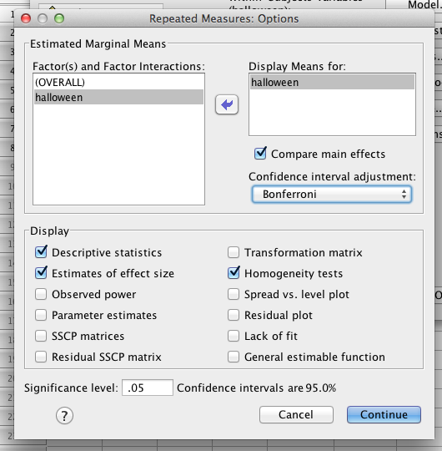
SPSS

Slide 32
Post Hocs
Bonferroni / Sidak are suggested to be the best, especially if you don’t meet Sphericity
Tukey is good when you meet Sphericity

Slide 33
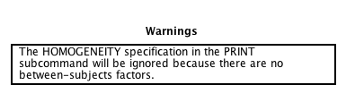
SPSS
Warning because I asked for Levene’s.

Slide 34
SPSS
Within-subjects factors – a way to check my levels are entered correctly.
Descriptive statistics – good for calculating Cohen’s d average standard deviation, remembering n for Tukey

Slide 35
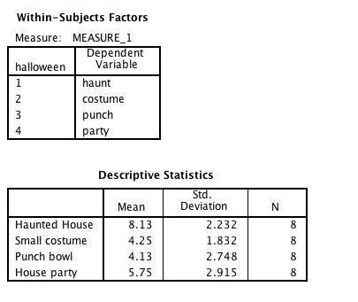
SPSS

Slide 36
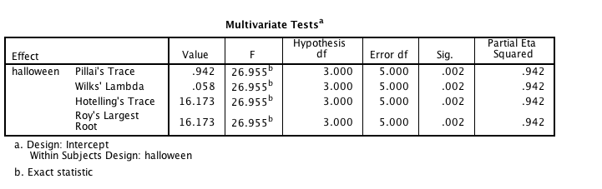
SPSS
Multivariate box – in general, you’ll ignore this

Slide 37
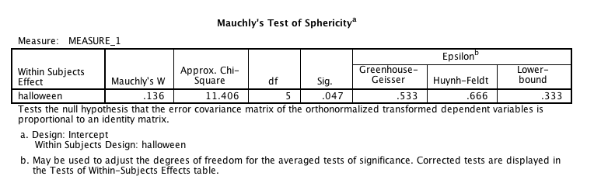
SPSS

Slide 38
Correcting for Sphericity
df = 3, 21
0.533 = 1.59
0.533 = 11.19
3
21
x
x
0.666 = 13.98
0.666 = 1.99
0.333 = 1.00
0.333 = 7.00

Slide 39
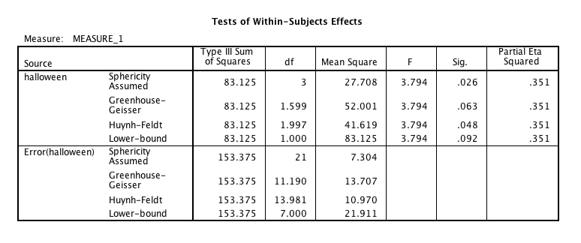
SPSS
Within subjects effects – the main ANOVA box.

Slide 40
SPSS
What to look at?
Under source = IV name = SSmodel
Error = SSresidual
Actually hides all the rest from you
Use only ONE line – pick based on sphericity issues

Slide 41
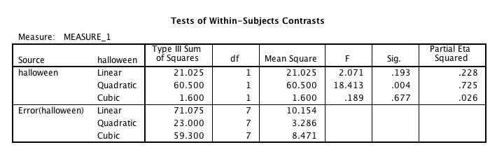
SPSS
Contrasts – you will also get trend analyses, ignore if that’s not what you are interested in testing

Slide 42
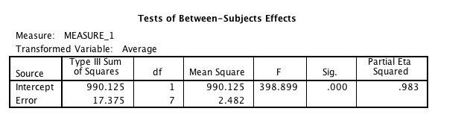
SPSS
Between subjects box – ignore unless you have between subjects factors (mixed designs).

Slide 43
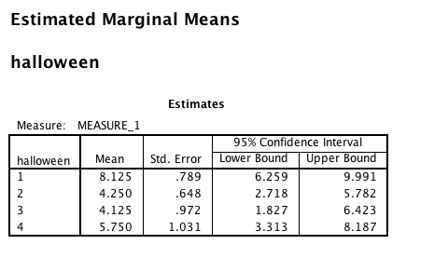
SPSS
Marginal means

Slide 44
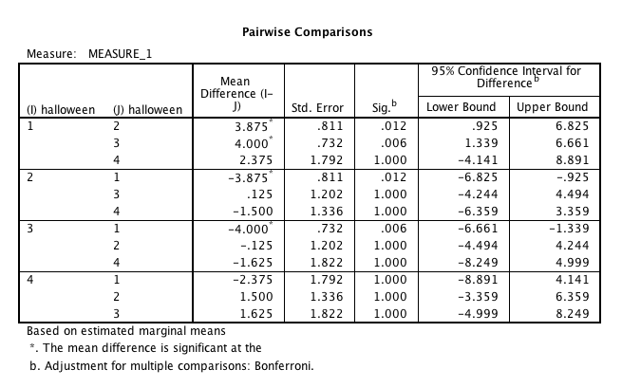
SPSS
Pairwise comparisons = post hoc

Slide 45
Post Hoc Options
You can also run:
Tukey LSD, but use a corrected Tukey HSD/Fisher-Hayter mean difference score
RM anovas on each pairwise (2 at a time) combination and use a corrected F critical from Scheffe
Run dependent t-tests and apply any correction

Slide 46
Post Hoc Options
Things to get straight:
Post hoc test: dependent t
Why? Because it’s repeated measures data
Post hoc correction: you pick: Bonferroni, Sidak, Tukey, FH, Scheffe

Slide 47

Effect size
Remember with a one-way design, eta = partial eta = R squared
Omega squared calculation: (that’s a little easier than the book one):

Slide 48
Two-Way Repeated Measures ANOVA
Chapter 14

Slide 49
What is Two-Way Repeated Measures ANOVA?
Two Independent Variables
Two-way = 2 IVs
Three-Way = 3 IVs
The same participants in all conditions.
Repeated Measures = ‘same participants’
A.k.a. ‘within-subjects’

Slide 50
An Example
Field (2013): Effects of advertising on evaluations of different drink types.
IV 1 (Drink): Beer, Wine, Water
IV 2 (Imagery): Positive, negative, neutral
Dependent Variable (DV): Evaluation of product from -100 dislike very much to +100 like very much)

Slide 51
SS_{T}
Variance between all participants
SS_{M}
Within-Participant Variance Variance explained by the experimental manipulations
SS_{R}
Between-Participant Variance
SS_{A}
Effect of Drink
SS_{B}
Effect of Imagery
SS_{A × B}
Effect of Interaction
SS_{RA}
Error for Drink
SS_{RB}
Error for Imagery
SS_{RA × B}
Error for Interaction

Slide 52
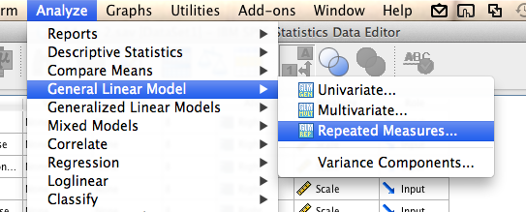
SPSS
Analyze > GLM > repeated measures

Slide 53
SPSS
Label the IVs
Remember that each IV gets its own label (so do not do one variable with the number of columns)
Levels = Levels of each IV
Hit Add

Slide 54
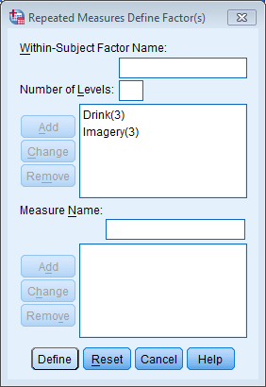
SPSS

Slide 55
SPSS
Now the numbers matter
First variable = first number in the (#, #)
Second variable = second number in the (#, #)
So (1,1) should be
IV 1 – Level 1
IV 2 – Level 1
Make sure they are ordered properly.

Slide 56
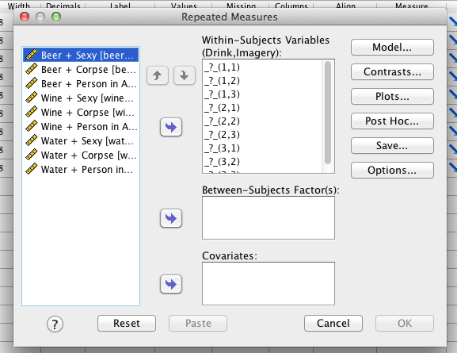
SPSS

Slide 57
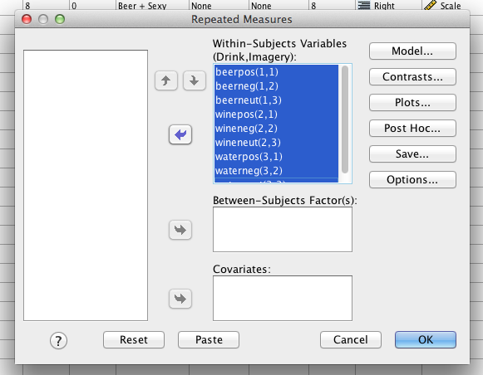
SPSS

Slide 58
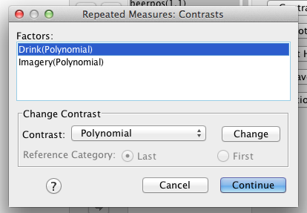
SPSS
Under contrasts, you will automatically get polynomial (trend), but you could change it
The descriptions of them are in chapter 11 notes.

Slide 59
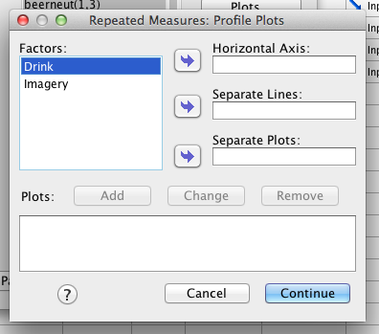
SPSS
Plots – since we have two variables, we can get plots to help us just see what’s going on in the experiment.

Slide 60
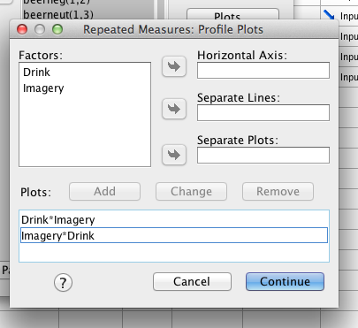
SPSS

Slide 61
SPSS
Under options:
Move the variables over!
Click compare main effects
Pick your test (remember we talked a lot about why I think dependent t is the shiz BUT that’s not true when you have multiple variables … why?)

Slide 62
SPSS
Under options
Remember we also talked about always asking for:
Descriptives
Effect size
Homogeneity because it won’t hurt you to get the error, but at least you won’t forget.

Slide 63
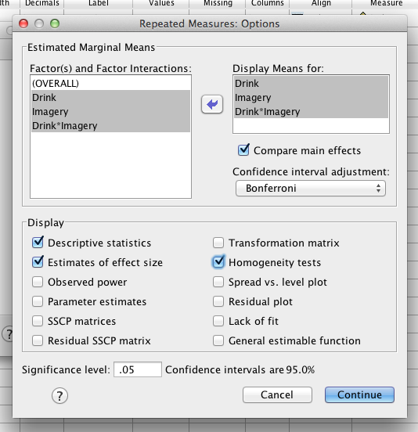
SPSS

Slide 64
SPSS
Hit ok!
Output galore!

Slide 65
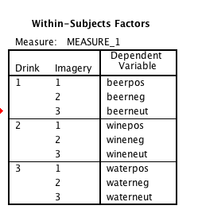
Within Subjects Factors
Did I line it all up correctly?
What the 1, 2, 3 labels mean

Slide 66
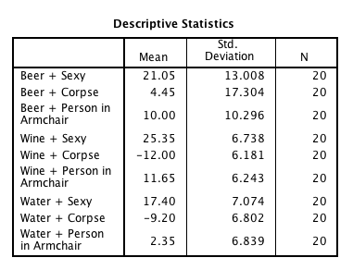
Descriptives
These are condition means – good for Cohen’s d because of SD

Slide 67
Multivariate Tests
Ignore this box – unless you decide to correct for Sphericity this way!

Slide 68
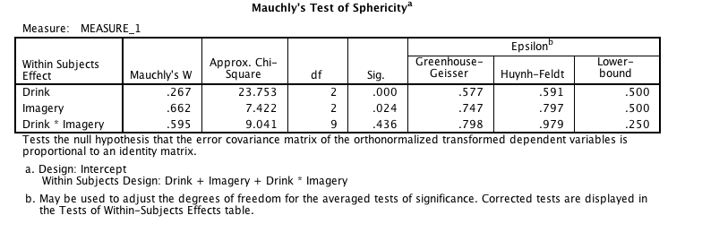
Sphericity

Slide 69
Sphericity
If we wanted to correct – we’d really do that first one … since epsilon is < .75 we would use Greenhouse-Geisser

Slide 70
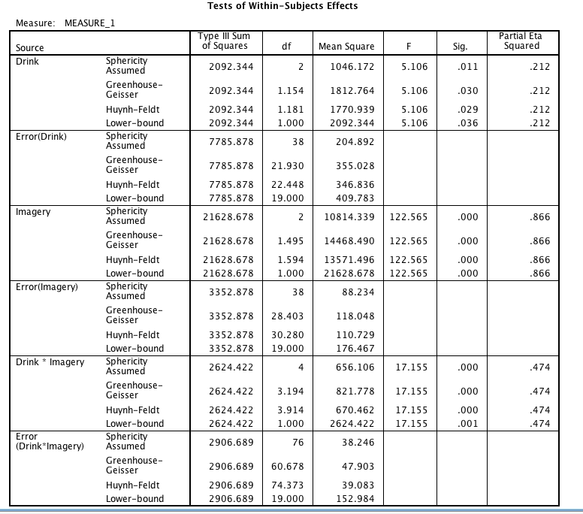

Slide 71
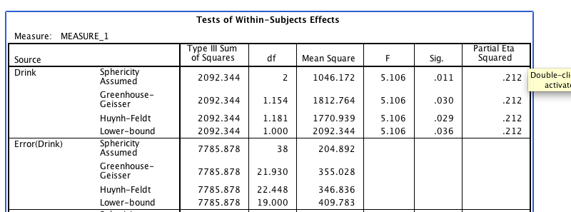
Main effect 1
F(2, 38) = 5.11, p = .01, n_{p}² = .21
F(1.15, 21.93) = 5.11, p = .03, n_{p}² = .21

Slide 72
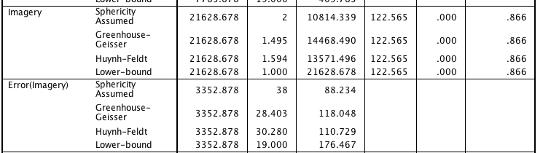
Main effect 2
F(2, 38) = 122.57, p < .001, n_{p}² = .87

Slide 73
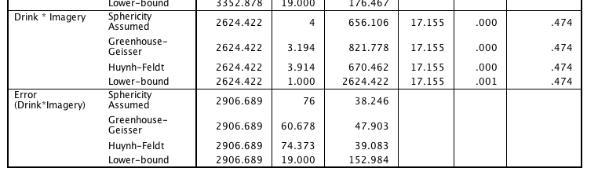
Interaction
F(4, 76) = 17.16, p < .001, n_{p}² = .47

Slide 74
Contrasts
Remember these only make sense if:
You selected particular ones you were interested in
You had a reason to think there was a trend (i.e. time based or slightly continuous levels)

Slide 75
Between subjects box
Ignore this box on totally repeated designs.

Slide 76
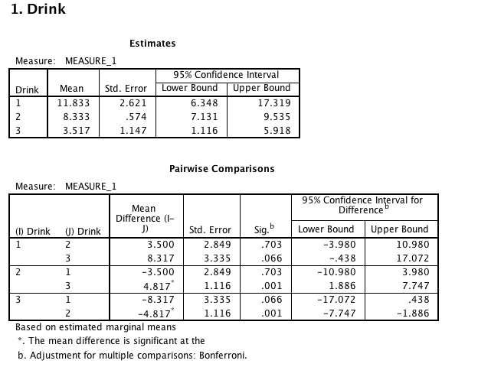
Marginal Means

Slide 77
Marginal Means
Before we used dependent t to analyze the effects across levels.
Now, it’s easier to ask SPSS to do marginal means analyses because it automatically calculates those means for you
You can also create new average columns that are those means (i.e. average all the levels of one IV to create a WATER level)

Slide 78
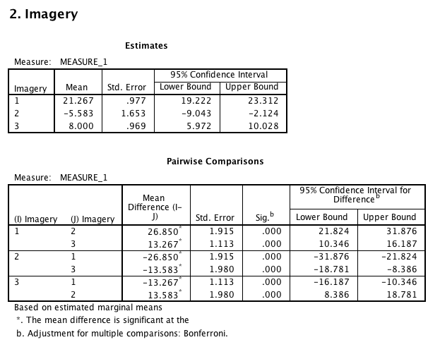

Slide 79
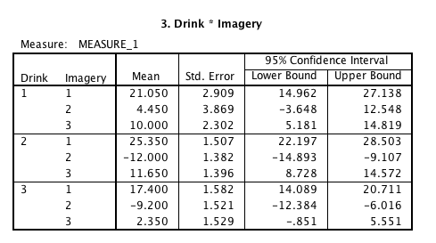
Interaction Means

Slide 80
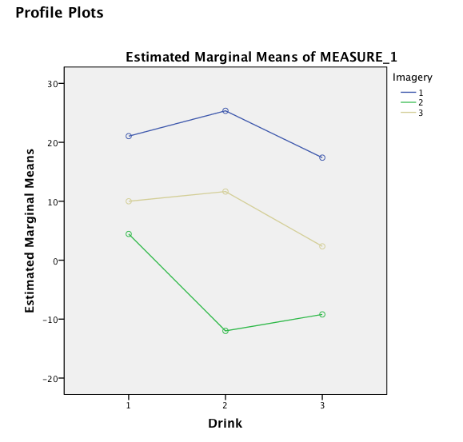
Plots

Slide 81
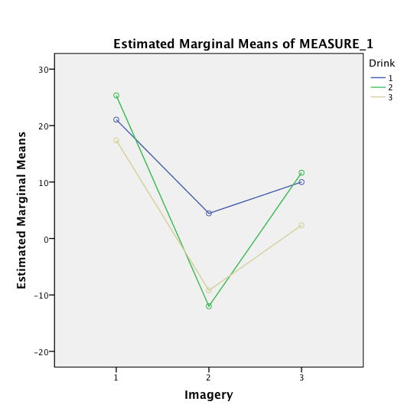

Slide 82
Simple effect analysis
Pick a direction – across or down!
How many comparisons does that mean we have to do?

Slide 83
Simple effects
Test = dependent t (because it’s repeated measures data)
Post Hoc = pick one!
Let’s do FH ☺

Slide 84
Correction
How many means?
3X3 anova = 9 means
FH = means – 1 for 9
DF residual = 76 (remember interaction)
Q = 4.40
Q* sqrt(msresidual / n)
4.40 * sqrt(38.25 / 20) = 6.08

Slide 85
Run the analysis
Analyze > compare means > paired samples

Slide 86
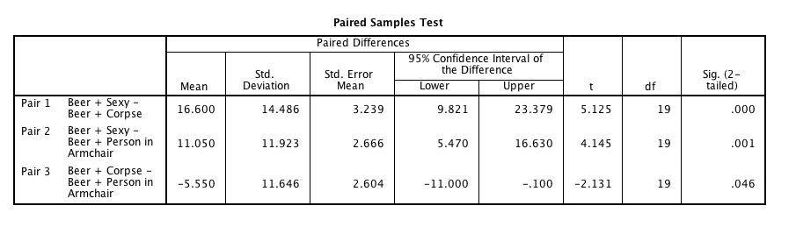
Example
First two are significant, last one is not because 5.55 < 6.08.

Slide 87
Effect sizes
Partial eta squared or omega squared for each effect
Cohen’s d for post hoc/simple effects
Remember there are two types, so you have to say which denominator you are using

